Slide 1

Note: The data and information in this document is reflective of a hypothetical situation and client. This document is to be used for KPMG Virtual Internship purposes only.
Sprocket Central Pty Ltd
Data analytics approach
KPMG Team – Herdy Cen

Slide 2
Note: The data and information in this document is reflective of a hypothetical situation and client. This document is to be used for KPMG Virtual Internship purposes only.
Agenda
Introduction
Data Exploration
Model Development
Interpretation

Slide 3
Note: The data and information in this document is reflective of a hypothetical situation and client. This document is to be used for KPMG Virtual Internship purposes only.
Introduction
Ideal new customers analyses
Three steps to be taken as a complete analyses progress would be broken down into each weekly.
Week 1 : Data Exploration
Week 2 : Model Development
Week 3 : Interpretation
There would be three main factors used as the input for the decision-making process which are Age, Job Industry and State.

Slide 4
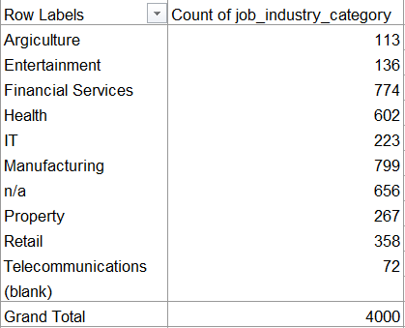
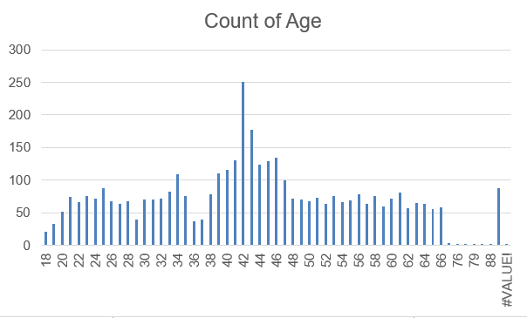
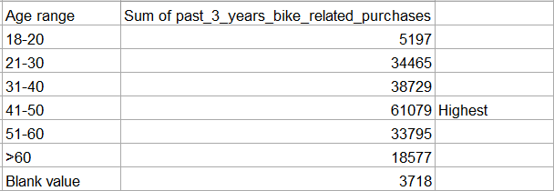
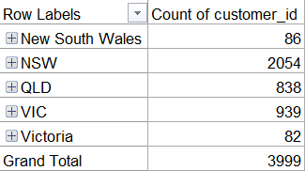
Note: The data and information in this document is reflective of a hypothetical situation and client. This document is to be used for KPMG Virtual Internship purposes only.
Data Exploration
Age Group, Job Industry and State Segmentation
People aged 41-50 had the most purchases within 3 years
Teenagers below 21 have the lowest demand among the others
Manufacturing and Financial services are the industries of around 40% of total customers
More than 50% of the current customers are the residents of New South Wales

Slide 5
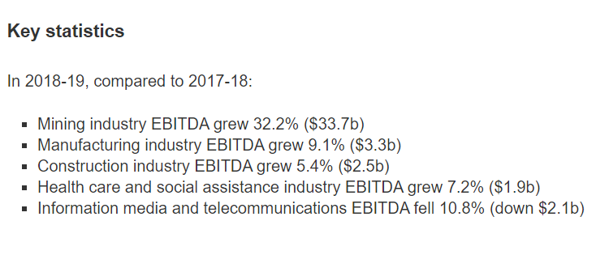
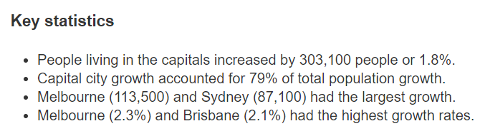
Note: The data and information in this document is reflective of a hypothetical situation and client. This document is to be used for KPMG Virtual Internship purposes only.
Model Development
Utilize and merge with external data
The state of Victoria and New South Wales are both having the largest growth in population with a difference of 26,400 populations
Manufacturing is the desirable target of job industry for the new customers due to its industry growth of $3.3b
Regional Growth 2018
Australian Industry 2018-19
Source: Australian Bureau of Statistics (ABS)

Slide 6
Note: The data and information in this document is reflective of a hypothetical situation and client. This document is to be used for KPMG Virtual Internship purposes only.
Interpretation
Compare and Contrast the Results
There are three summaries derived from the methodology, which are:
Citizen of New South Wales would be the ideal focus on the marketing target
The main job industries would be both Manufacturing and Financial Services due to the close gap of the number of people working in both industries which is shown in both current and new customers table.
For the age group, it would be desirable to target late thirties to late forties. Current customers aged 38-46 would be the one with the most bike purchased. Additionally, new customers’ list shows that people aged 41-50 have the highest demand in bike. Thus, it is safe to derive that the age range group should be around 38-50.

Slide 7
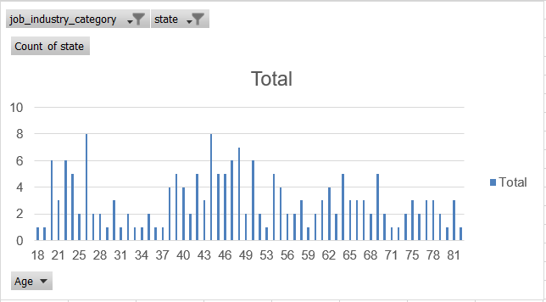
Note: The data and information in this document is reflective of a hypothetical situation and client. This document is to be used for KPMG Virtual Internship purposes only.
Interpretation
End Results
There would be a total of 187 out of 1000 new customers to be targeted to bring out the optimal result for Sprocket.

Slide 8
Note: The data and information in this document is reflective of a hypothetical situation and client. This document is to be used for KPMG Virtual Internship purposes only.
Appendix

Slide 9
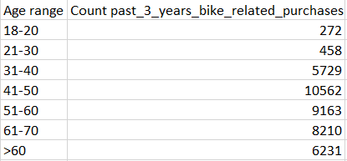
Note: The data and information in this document is reflective of a hypothetical situation and client. This document is to be used for KPMG Virtual Internship purposes only.
Appendix
Appendix 1

